Slide 1
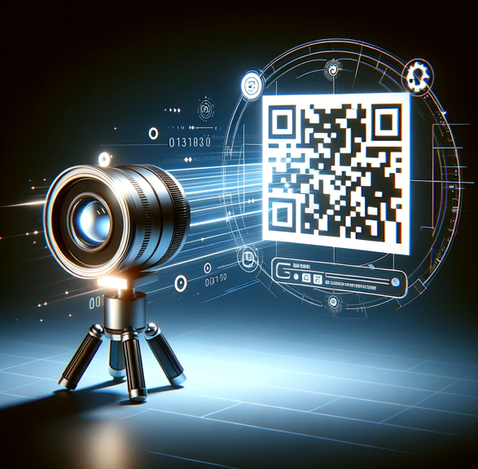
Motor Skills Analysis App

Slide 2
How we can effectively make a difference
There exist several conditions that affects the motor and coordination skills of the patient, among which Developmental Coordination Disorder (DCD), also known as Dyspraxia.
In such cases, early intervention with occupational and physical therapy is of paramount importance. However, the progress advances at a slow pace, and the effectiveness of the treatment cannot be appreciated until later on.
Our product provides, therefore, a valuable tool to quantify such results, rendering them tangible, no matter how small they are. And thus, it can help save valuable time in the choice of the most suitable treatment for the patient.

Slide 3
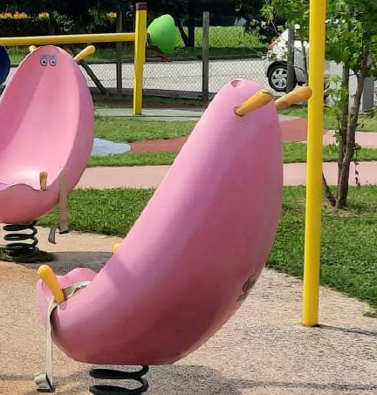
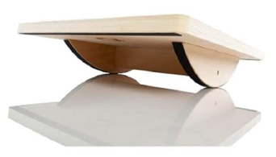
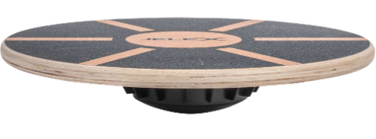
Introducing Our Innovative Motor Skills Analysis App
A brief overview of the product:
An application that analyzes videos to gather useful information for assessing the motor skills of children with disabilities.
The following presentation will use as reference the spring chair designed by IPS: Inclusive Play Solutions. However, the product can be easily applied to any item where the motor skills can be assessed by studying the oscillations of the subject. This renders the product highly scalable due to its adaptability to pre-existing instruments, which become monitorable simply by attaching on them a printed QR code in a visible and strategic position, thus eliminating the costs of manufacturing from scratch sensorized equipment.

Slide 4
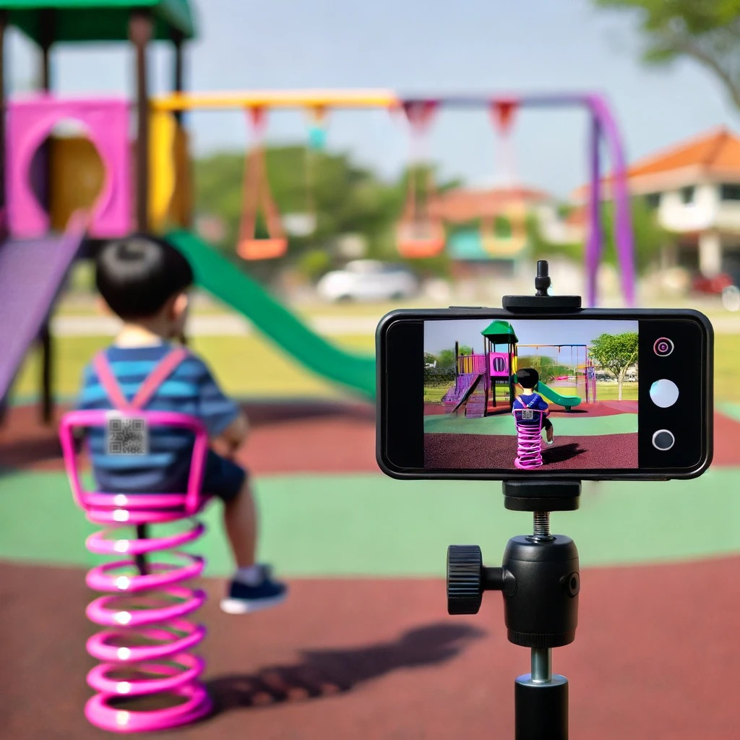
How it works
A video is recorded using a mobile phone by a parent.
The video should capture the child on the spring chair.
The QR code (provided with the product) is placed on the spring chair.
The phone is positioned on a stable surface. A tripod (which can be provided with the product) can be used.
The video is uploaded to the computer application for analysis.
Photo with illustrative purposes

Slide 5
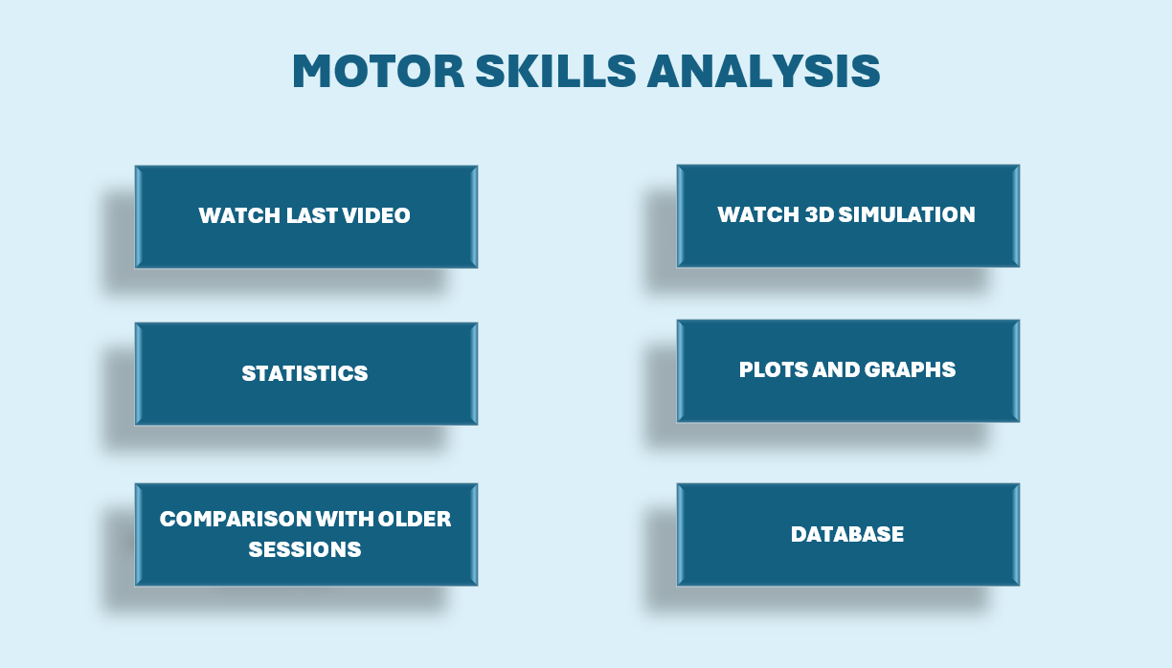
User interface idea:
Simple design
Wide range of options and available data

Slide 6
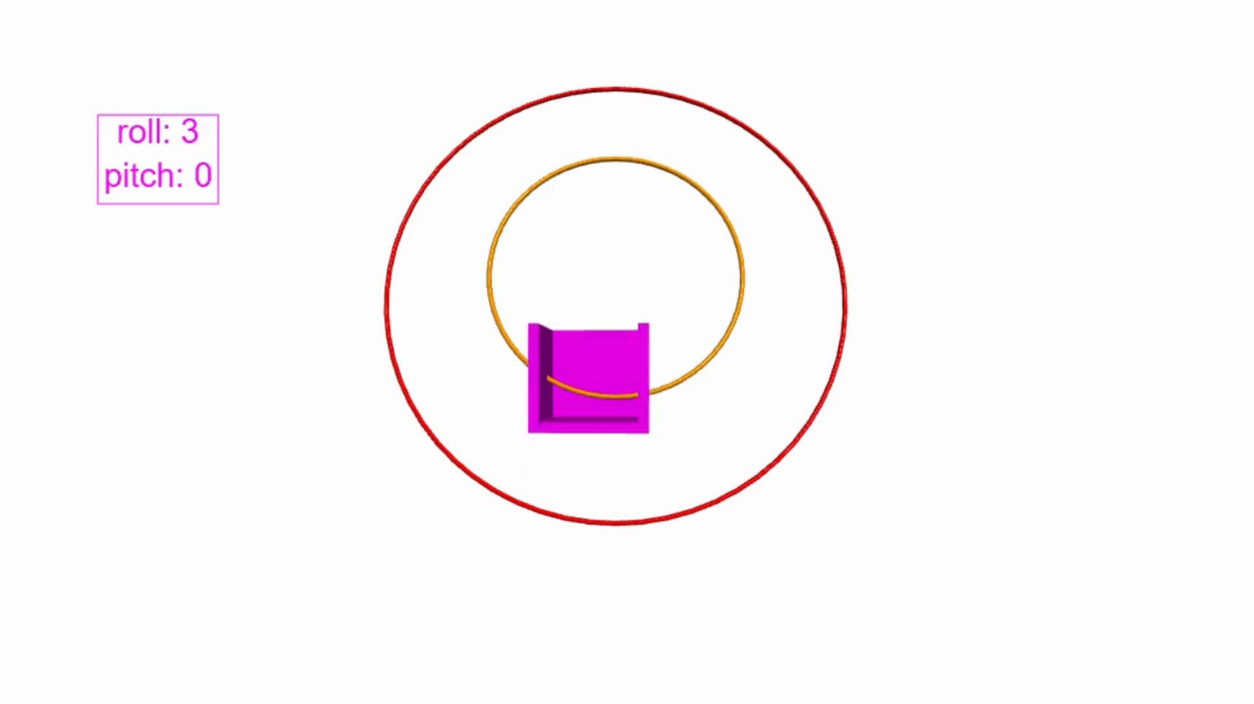
Understanding the Analysis:
3D movement visualization:
Shows movements of the chair.
Includes concentric circles at the balance point to represent thresholds.
The therapist sets threshold values, which get smaller as the child progresses.
Helps parents verify progress in a fun environment like a playground.

Slide 7
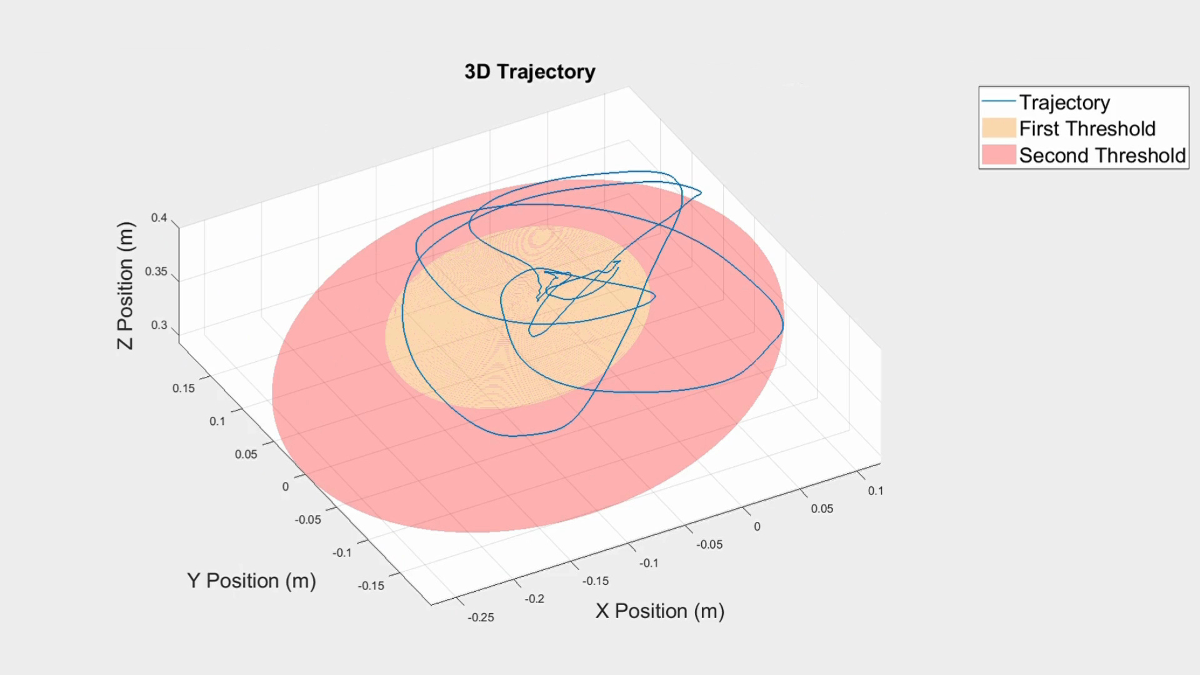
Understanding the Analysis:
Graphs and plots:
Give powerful and accurate data to therapists.
Give simple feedbacks to parents, too.
Other features:
How many times the child exceeds the limits.
Duration of maintaining balance.
In general, any data concerning time and orientation.

Slide 8
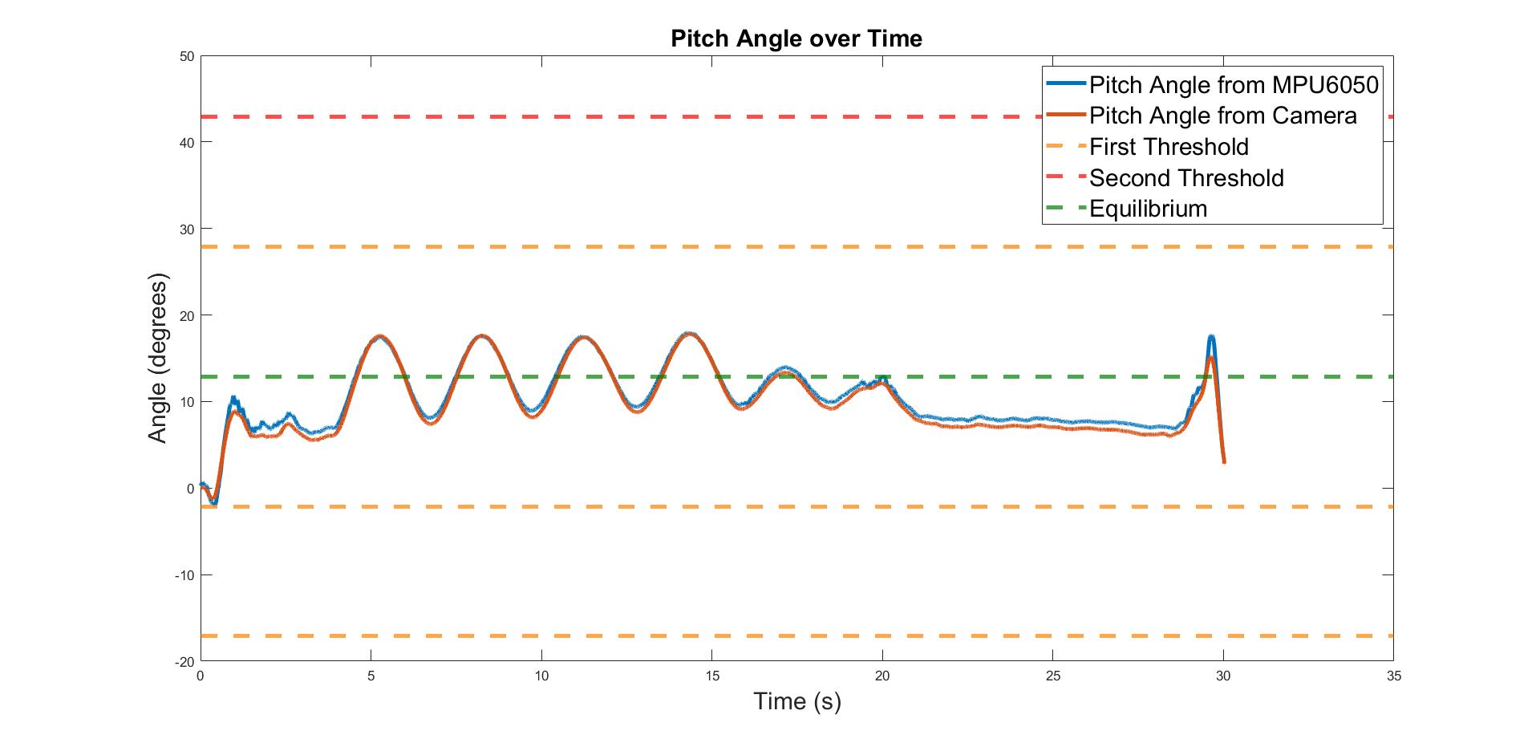
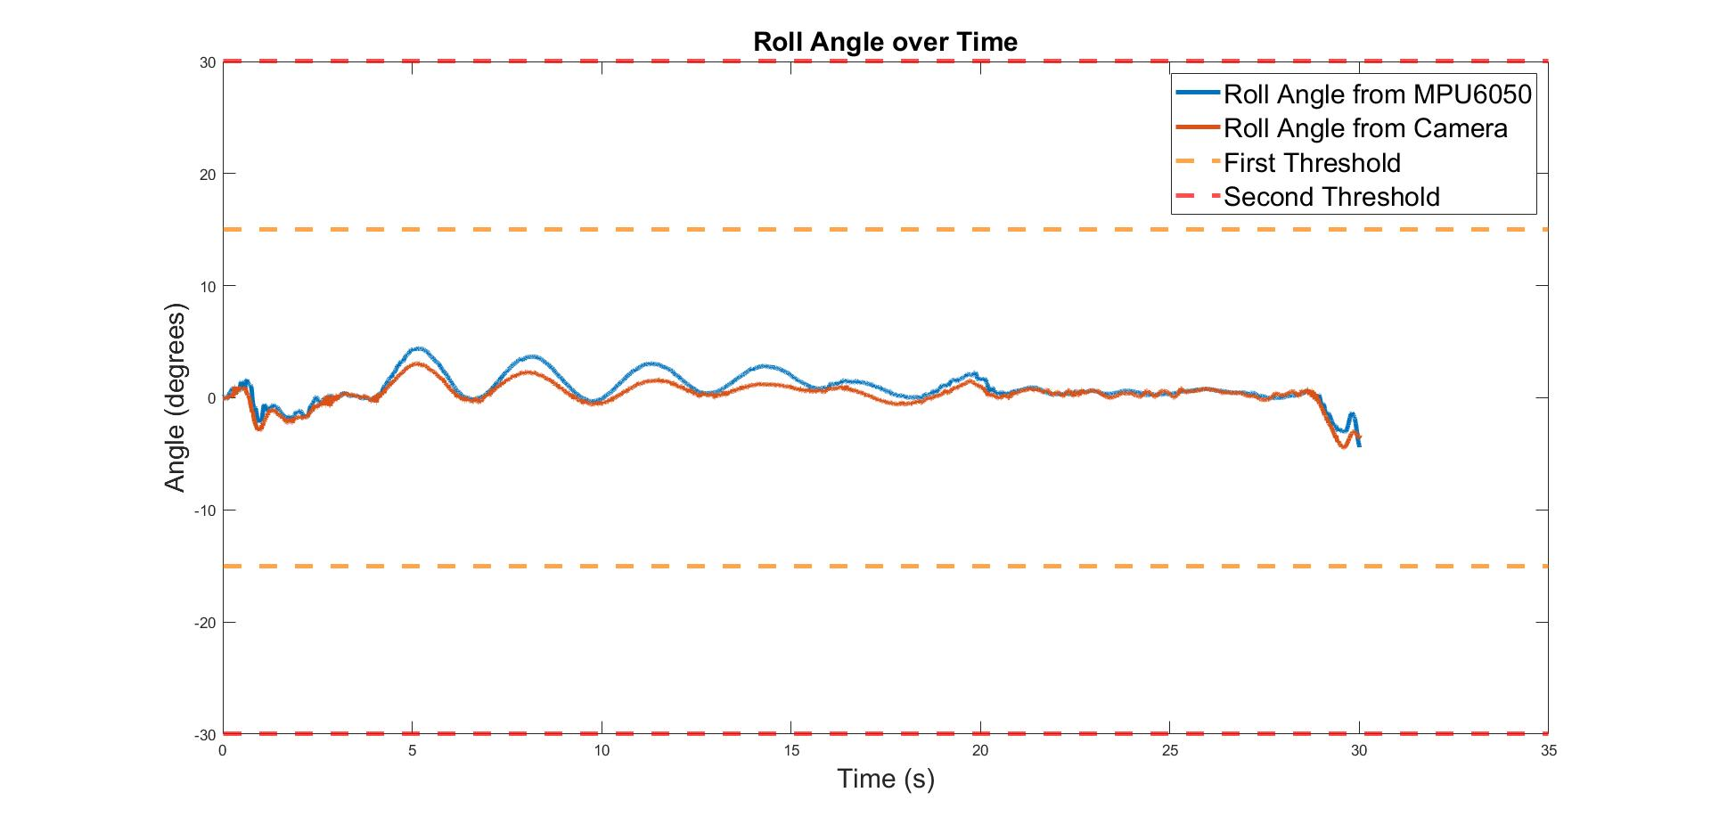
Validating the Accuracy of Our Product
Experiment setup with the spring chair given by IPS.
Data collection and analysis using computer vision.
Comparison with Arduino-MPU6050 sensor data: results showed negligible error, confirming the reliability of computer vision.
As a result, the accuracy of the product is highly reliable
Maximum error observed under 3 degrees

Slide 9
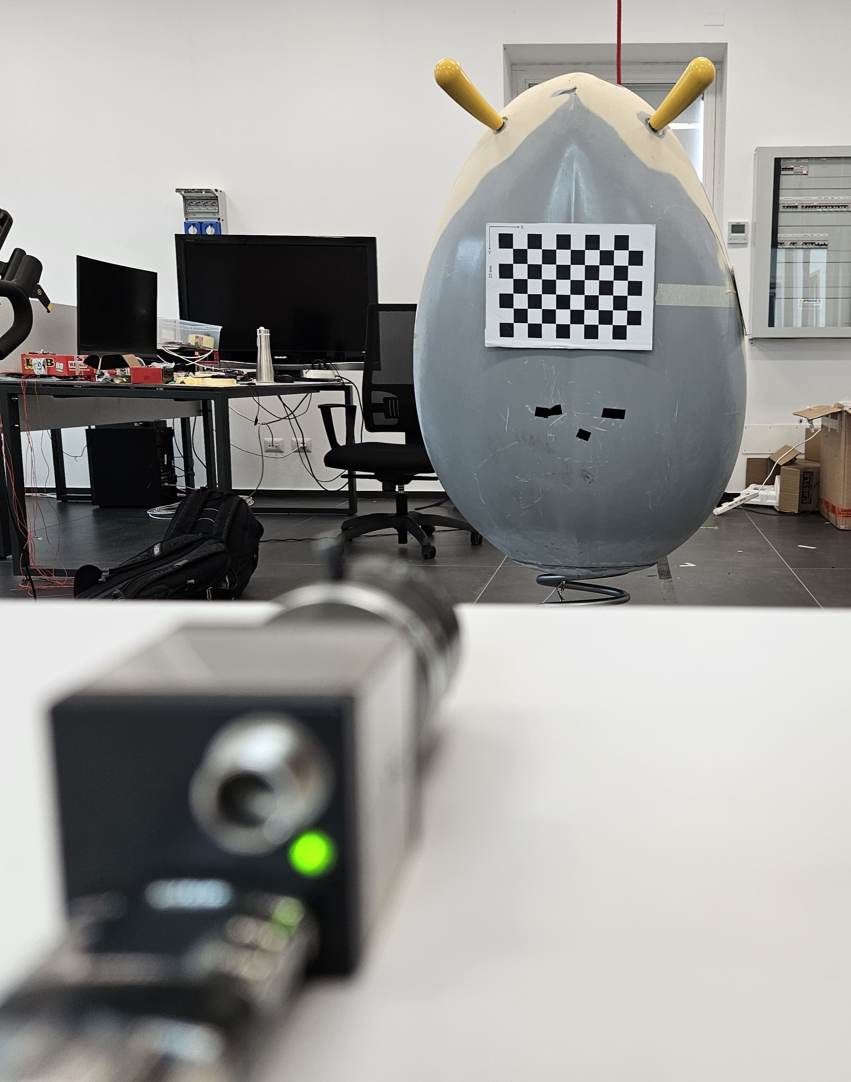
Computer Vision
Camera calibration:
Calibration provides essential internal camera parameters.
The parent takes about 10 photos of the QR code, una tantum.
Video acquisition:
Videos can be taken in black and white for better quality.
Frame rate set between 20-50 fps to capture all chair movements.
Experiments conducted using IDS peak cockpit software.
Video processing:
Analysis performed in PyCharm using Python functions.
Extraction of rotation vectors over time and 3D reconstruction.

Slide 10
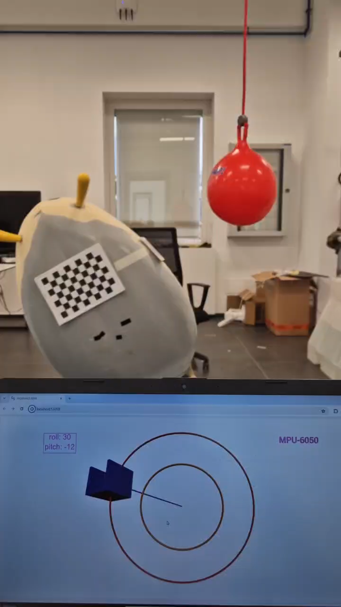
Data Acquisition with Arduino
Arduino and MPU-6050 located under the chair.
Utilization of both accelerometer and gyroscope of the sensor.
Filtering and combining acceleration and angular velocities for noise reduction, by use of Complementary Filter.
Real-time simulation feedback during the experiment
10

Slide 11
Position In The Market
The therapist perspective:
The analysis of these type of situations is usually performed in a qualitative way.
This is considered of course a significative limitation for the effectiveness of the treatments.
For this reason, therapists are looking for ways to guarantee more precise and quantitative analyses.
Our product aims at addressing this need.

Slide 12
Market Comparisons
Current market solutions:
Video analysis of patients performing specific movements in specific settings.
Analysis using gyroscopes and accelerometers which require stable attachment to the patient.
Unique features of our solution:
Playful: Designed to work also in a playful context.
Non-invasive: No need for the child to hold or wear any devices. The only thing required is QR code attached on the toy.
Cost-effective: Other than the QR code and eventually the tripod, no equipment needed outside a regular smartphone and computer.
Compact: QR code and tripod are pocket-sized.
Easy to use: Just apply the QR code and record a video
No power supply needed: It doesn't require a battery nor other form of alimentation

Slide 13
Thank you
Messina Pietro
Occhinero Veronica
Palmieri Serena

